Slide 1
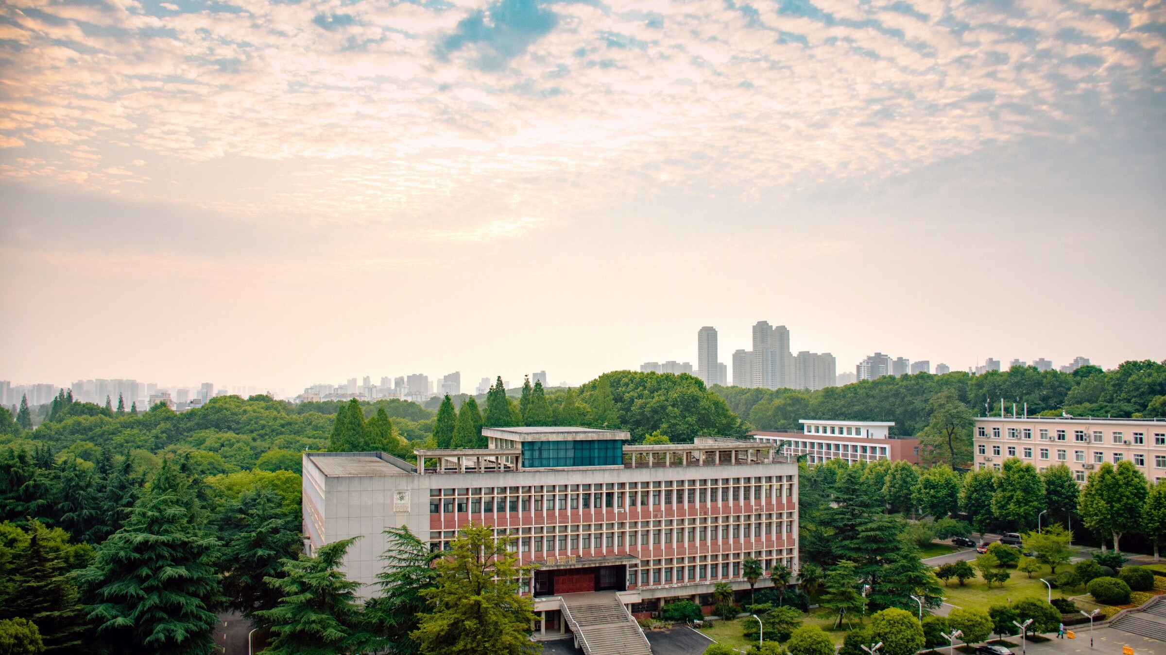


A Framework for Digital Crop Growing Modeling based on Agricultural Internet of Things
Lin Yang, Can Deng, Zhilong Bie, Yu Chen, Xiuwen Fu, Grancarlo Fortino
2022.09.05
Notes:
尊敬的各位专家，领导，您们好，我来自华中农业大学，我叫邓灿，今天我给大家带来的是 A framework for digital crop growing modeling based on agricultural internet of things这篇论文，我将从以下4个方面对这篇论文做一个基本的讲解。

Slide 2
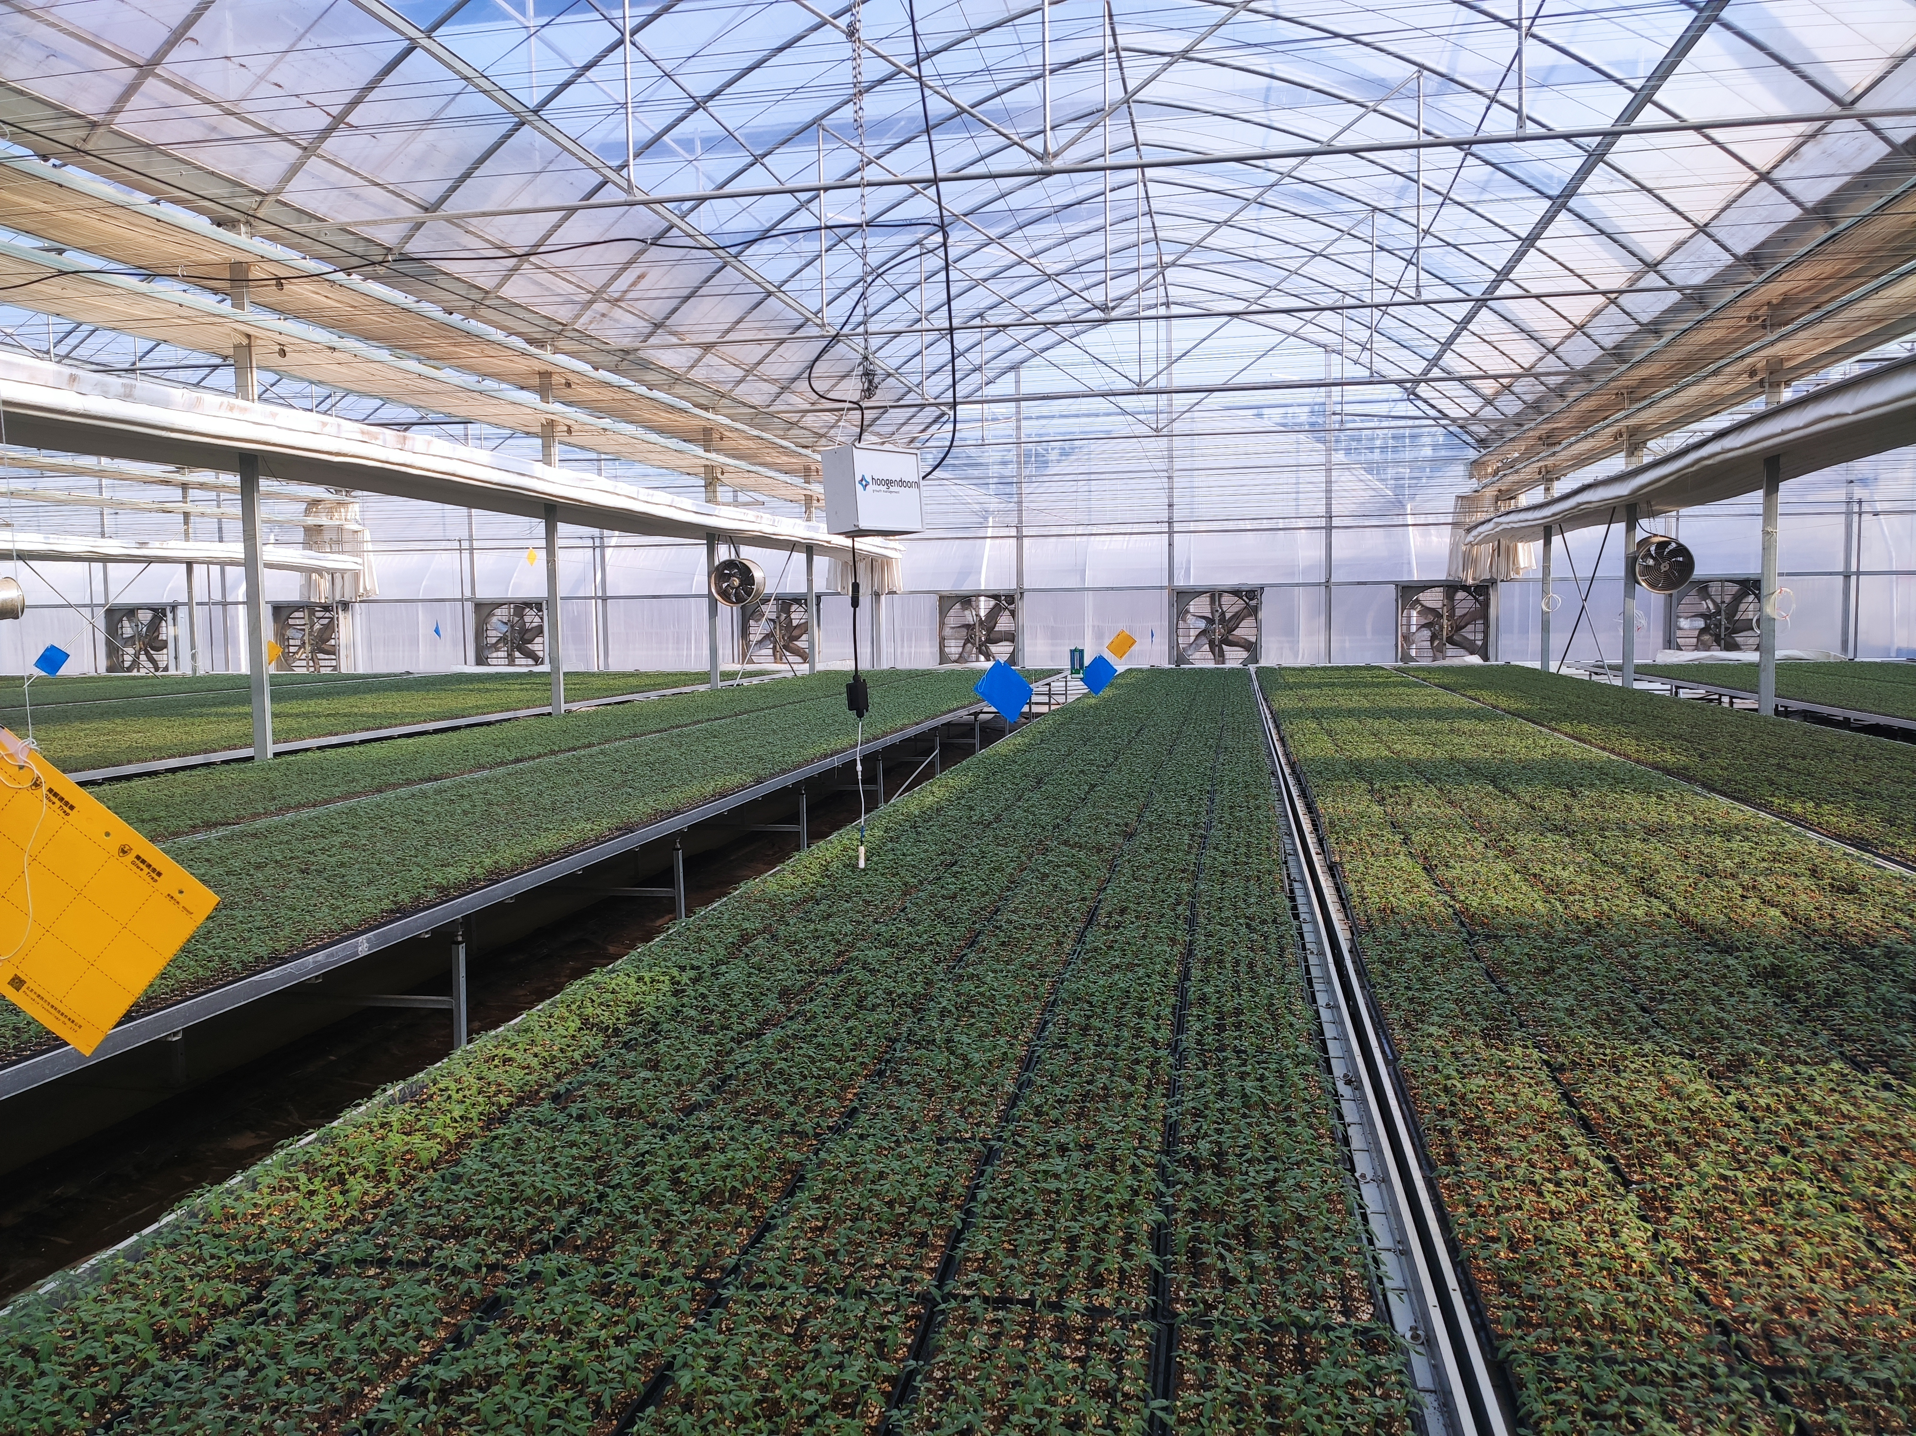
Content
01.
Research Background
02.
Research Methods
03.
Prototype Experiments
04.
Conclusions
Notes:
分别是1.research background. 2.research methods 3.prototype experiments 4.conclusions
首先，第一部分是research background

Slide 3
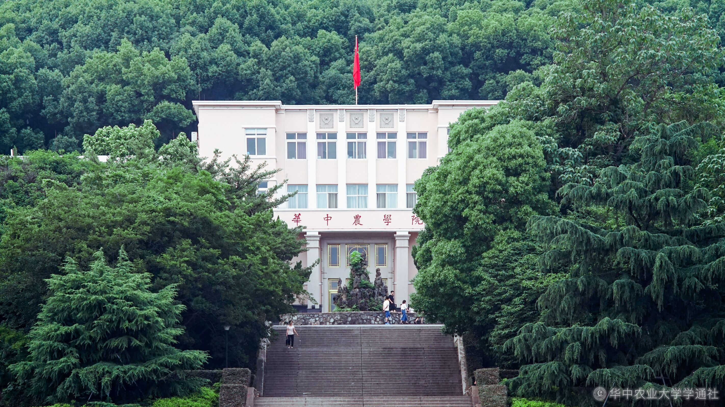
01
Research Background

Slide 4
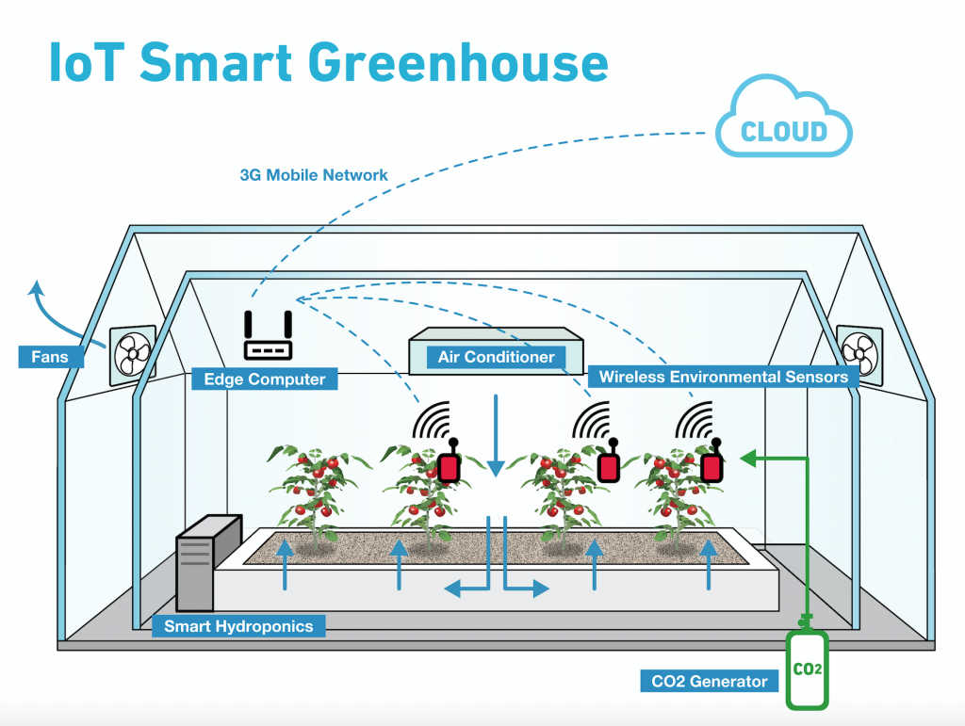
Research Background
Crop in China
Notes:
中国温室面积在逐年递增，且已具备较大规模。这使得大量物联网设备广泛部署于温室等环境可控农业领域，作物生长节奏、品质受环境因子影响较大，物联网环境调控成为提升农业生产效率的关键方法。而标准化与数字化的作物长势描述、定量和智能化环境调控，是实现工厂化大规模农业生产的前提条件。作物生长模型是这一问题的关键。因此，借助新兴的物联网技术，探索数值化、数学化描述作物生长过程，对于智慧农业的高效生产具有较大意义。

Slide 5
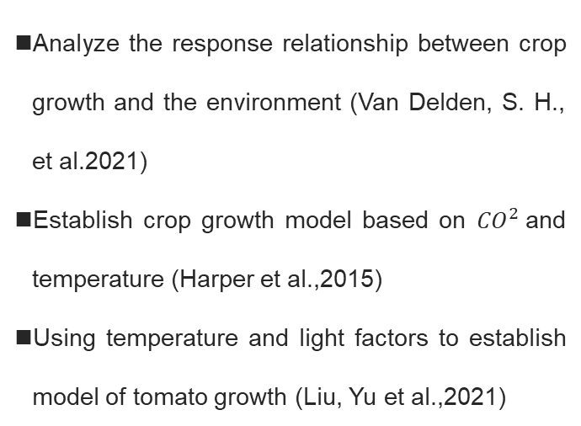
Research Background
Related Work
Crop grow model
Internet of things
Analyze the response relationship between crop growth and the environment (Van Delden, S. H., et al.2021)
Establish crop growth model based on ${CO}^{2}$and temperature (Harper et al.,2015)
Using temperature and light factors to establish model of tomato growth (Liu, Yu et al.,2021)
Precision agriculture with the Internet of things(SharathKumar et al.,2020)
Soil data collection with the help of Internet of things(Lund et al.,2022)
Target detection of shiitake mushrooms with the help of Internet of things technology(Yifan, et al.,2022)
Notes:
已有较多文献对农业数字化系统进行了研究。作物生长模型可以合理量化研究作物生长和发育的过程，并分析作物生长与环境之间的响应关系。但基于传统的数据测量与采集模式，对作物具有不可再生的破坏。同时，已有学者借助物联网技术探索生长模型的构建及应用工作。这些研究采取无损的数据采集方式，为作物生长数字模型构建提供了基础，但较少的考虑综合环境因素与作物表型的定量化描述。

Slide 6
02
Research Methods

Slide 7
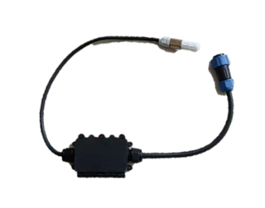
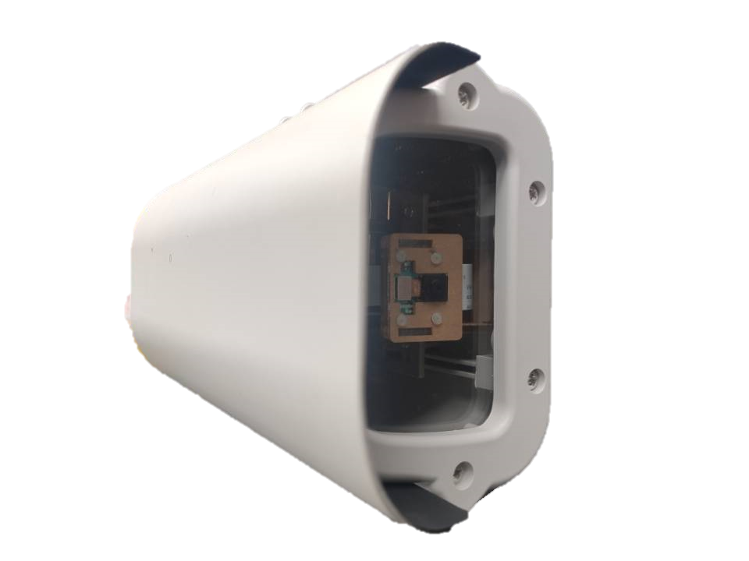


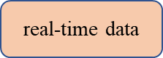
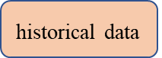
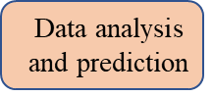
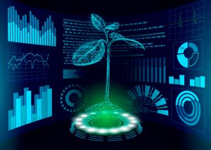
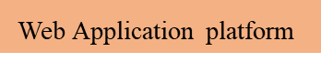
Research Methods
The Framework of the CGM Online Modeling
Greenhouse 1
temperature
PAR
humidity
user
CEI Model
Edge device data
JSON
HTTP
Greenhouse N
GCI Model
Plant height
Stem diameter
leaf area
Environment perception and phenotype detection layer
Crop growth model cloud
User modeling interaction layer
Notes:
基于上述研究背景，我们专门设计了一种作物生长数字模型在线建模系统架构。该架构分为环境感知与作物表型检测层、作物生长模型（Crop Growing Model, CGM）云和终端应用层。每层之间采用标准的无线通讯方式和接口协议进行连接，采取松散耦合的方式集成。

Slide 8
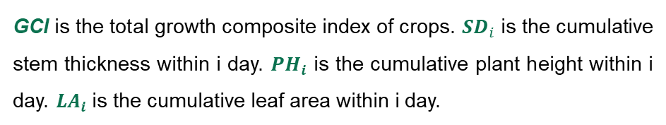
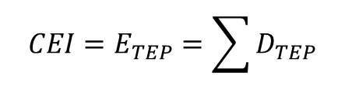
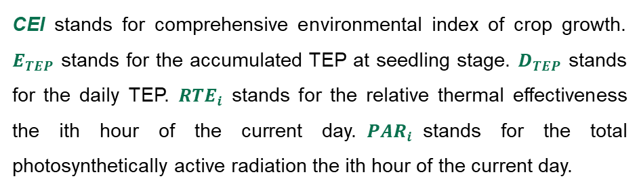
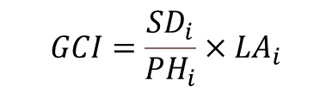
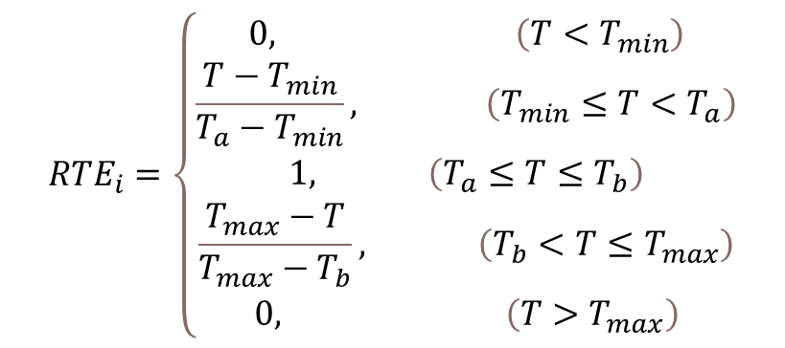
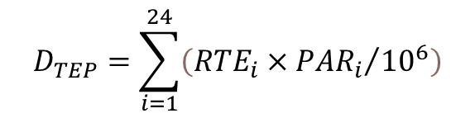
Research Methods
Crop Growing Modeling Algorithm
CEI stands for comprehensive environmental index of crop growth. $E_{TEP}$ stands for the accumulated TEP at seedling stage. $D_{TEP}$ stands for the daily TEP. ${RTE}_{i}$ stands for the relative thermal effectiveness the ith hour of the current day.${PAR}_{i}$stands for the total photosynthetically active radiation the ith hour of the current day.
$$CEI=E_{TEP}=\sum{D_{TEP}}$$
$$D_{TEP}=\sum_{i=1}^{24}{\left({RTE}_{i}×{{PAR}_{i}}/{{10}^{6}}\right)}$$
$${RTE}_{i}=\left\{\begin{matrix}0, \left(T<T_{min}\right) \\ \frac{T−T_{min}}{T_{a}−T_{min}}, \left(T_{min}≤T<T_{a}\right) \\ \begin{matrix}1, \left(T_{a}≤T≤T_{b}\right) \\ \begin{matrix}\frac{T_{max}−T}{T_{max}−T_{b}}, \left(T_{b}<T≤T_{max}\right) \\ 0, \left(T>T_{max}\right)\end{matrix}\end{matrix}\end{matrix}\right.$$
GCI is the total growth composite index of crops. ${SD}_{i}$is the cumulative stem thickness within i day. ${PH}_{i}$ is the cumulative plant height within i day. ${LA}_{i}$is the cumulative leaf area within i day.
$$GCI=\frac{{SD}_{i}}{{PH}_{i}}×{LA}_{i}$$
the GCI of Crop Growth
the CEI for Environment Fusion
Notes:
我们构建了一种多因素融合的作物生长模型，提出了一种综合环境耦合方法。
其中综合环境指数是对多个单一环境因素的融合。辐热积通常被用来评估太阳辐射与温度的累计程度，适合本文所提多环境因素耦合的情形。为此，可考虑采用辐热积评估作物干物质累积过程。
单一的作物器官指标无法评估作物的长势健康与强壮状态。为此，本文采取图像边缘设备直接测量的作物器官表型数据，构建作物长势综合指数。

Slide 9
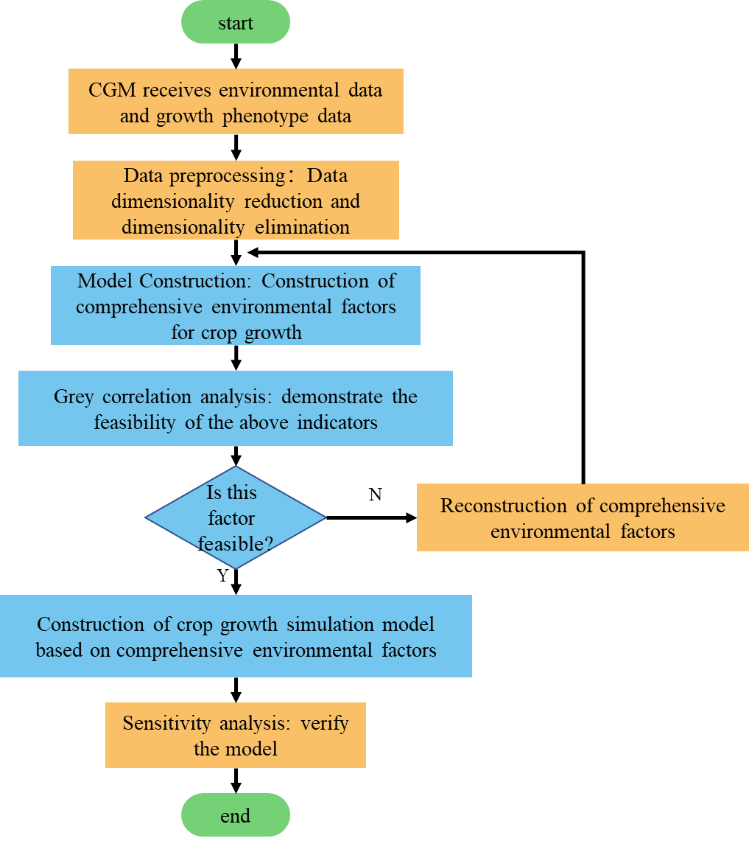
Research Methods
Digital Model Fitting Algorithm
Environmental data: air temperature, air humidity and PAR, etc.
Crop organ phenotype data : plant height, stem thickness, leaf area, etc.
Input: environmental data and crop organ phenotype data.
Fitting algorithm: data fusion, grey correlation analysis and data fitting.
Output: digital crop growing modeling.
Notes:
作物数字模型拟合算法，如图所示。该算法运行于CGM云。算法的输入为：CGM接收边温室边缘设备上传的环境数据和作物器官表型数据。通过上述综合评价指标进行数据融合，并进行灰色关联度分析获取可行建模参数，CGM将对综合环境因子与作物生长综合指标进行拟合，构建作物生长数字模型。

Slide 10
03
Prototype Experiments

Slide 11
Prototype Experiments
Demonstrate the Feasibility and Applicability of CEI
Experience group
Control group
 | Proposed CEI | Radiation | Temperature | Humidity | ATM | VPD
Plant height | 0.764 | 0.564 | 0.628 | 0.622 | 0.617 | 0.612
Stem thickness | 0.511 | 0.554 | 0.666 | 0.654 | 0.646 | 0.642
Leaf area | 0.727 | 0.639 | 0.654 | 0.653 | 0.652 | 0.650
Whole plant dry weight | 0.808 | 0.647 | 0.684 | 0.681 | 0.678 | 0.673
Proposed GCI | 0.777 | 0.616 | 0.645 | 0.643 | 0.640 | 0.637
 | Proposed CEI | Radiation | Temperature | Humidity | ATM | VPD
Plant height | 0.738 | 0.669 | 0.601 | 0.589 | 0.600 | 0.649
Stem thickness | 0.522 | 0.857 | 0.734 | 0.710 | 0.733 | 0.808
Leaf area | 0.697 | 0.659 | 0.654 | 0.653 | 0.654 | 0.660
Whole plant dry weight | 0.807 | 0.723 | 0.707 | 0.702 | 0.707 | 0.717
Proposed GCI | 0.805 | 0.691 | 0.659 | 0.649 | 0.659 | 0.663
Notes:
为了验证模型的可行性，本文以西瓜种苗为例进行建模实验。
西瓜苗培育实验采集了两次数据，分别为测试集和验证集。为了论证选取的环境综合指数的可行性与适用性，我们采取了灰色关联度分析的数学方法。两次数据的灰色关联度矩阵，如表所示。相较于其他环境因子，辐热积与植物几何尺寸因素的关联度普遍偏大。

Slide 12
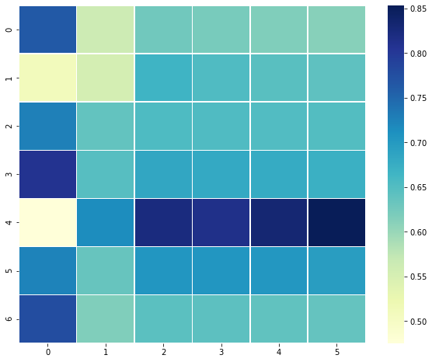
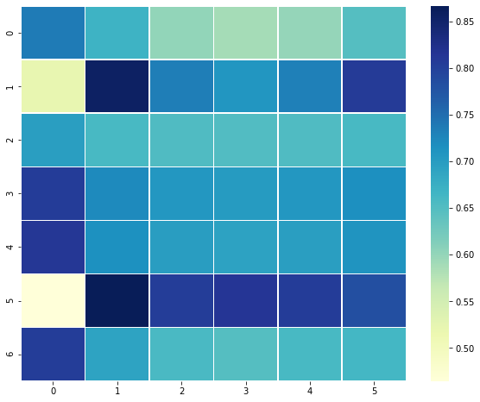
Prototype Experiments
Demonstrate the Feasibility and Applicability of CEI
Experience group
Control group
Notes:
同时为了更加直观地反映表格中的数据信息，我们采用热力图的可视化方式，以颜色深浅来表示数据的相关强度。两次数据矩阵的热力图，如图所示。第一列颜色偏深，直观的描述了辐热积与植物几何尺寸的关联度更强，有力的论证了辐热积作为综合环境指数的可行性。

Slide 13
Prototype Experiments
Digital model of watermelon seedling growth
Notes:
借助matlab工具，将西瓜种苗长势综合指数与综合环境指数进行拟合，构建了西瓜种苗生长模型如图所示。作物生长走势符合生物生长的Logistic曲线的前半部分，该拟合函数符合植物生长的客观规律。

Slide 14
Prototype Experiments
Hybrid validation of CGM
Hybrid validation of radiant heat product fitting model based on plant height
Hybrid Validation of Radiant Heat Product Fitting Model Based on Leaf Area
Notes:
将实验组与对照组的拟合函数放置在同一个坐标轴下，以便分析构建的植物生长模拟模型的差异性与普适性，从函数图像可以看出，两组实验的函数走势基本吻合，从宏观上符合作物生长的客观规律。

Slide 15

Prototype Experiments
Using RMSE to model accuracy
98%+
Varieties | Plant height |  | Leaf area |  | Proposed GCI
 | R² | RMSE | R² | RMSE | R² | RMSE
Experience group | 0.984 | 0.568 | 0.983 | 2.646 | 0.989 | 0.006
Varieties | Plant height |  | Leaf area |  | Proposed GCI
 | R² | RMSE | R² | RMSE | R² | RMSE
Control group | 0.943 | 0.698 | 0.998 | 1.195 | 0.988 | 0.010
Model accuracy：
Based on regression analysis, RMSE is used to test the accuracy of the model.
The closer R2 is to 1, and the closer the RMSE is to 0, the higher the accuracy of the model.
The prediction results show that: R2 is above 0.98, and RMSE is below 0.1.
The model accuracy can reach more than 98%.
$R^{2}$ & RMSE
Notes:
以回归分析为基础，指标采用标准误差RMSE统计方法来检验模型的精度敏感性。表格是经计算得出的两组实验的决定系数与回归估计标准误差。其中R2均在0.98以上，RMSE均在0.1以下，这说明作物生长模型的精度达到了98%以上。

Slide 16
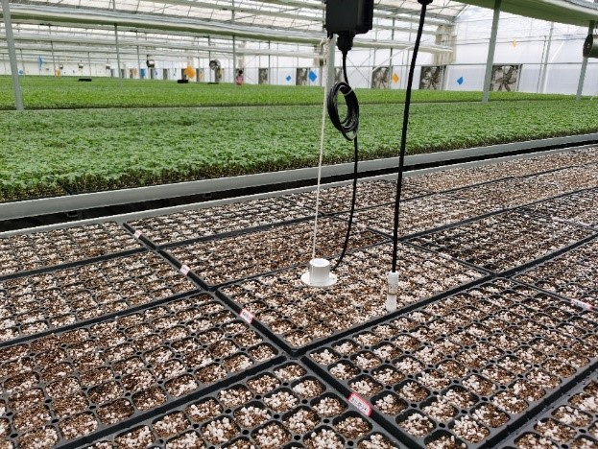
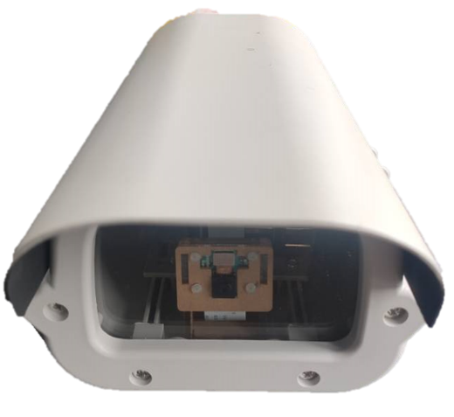
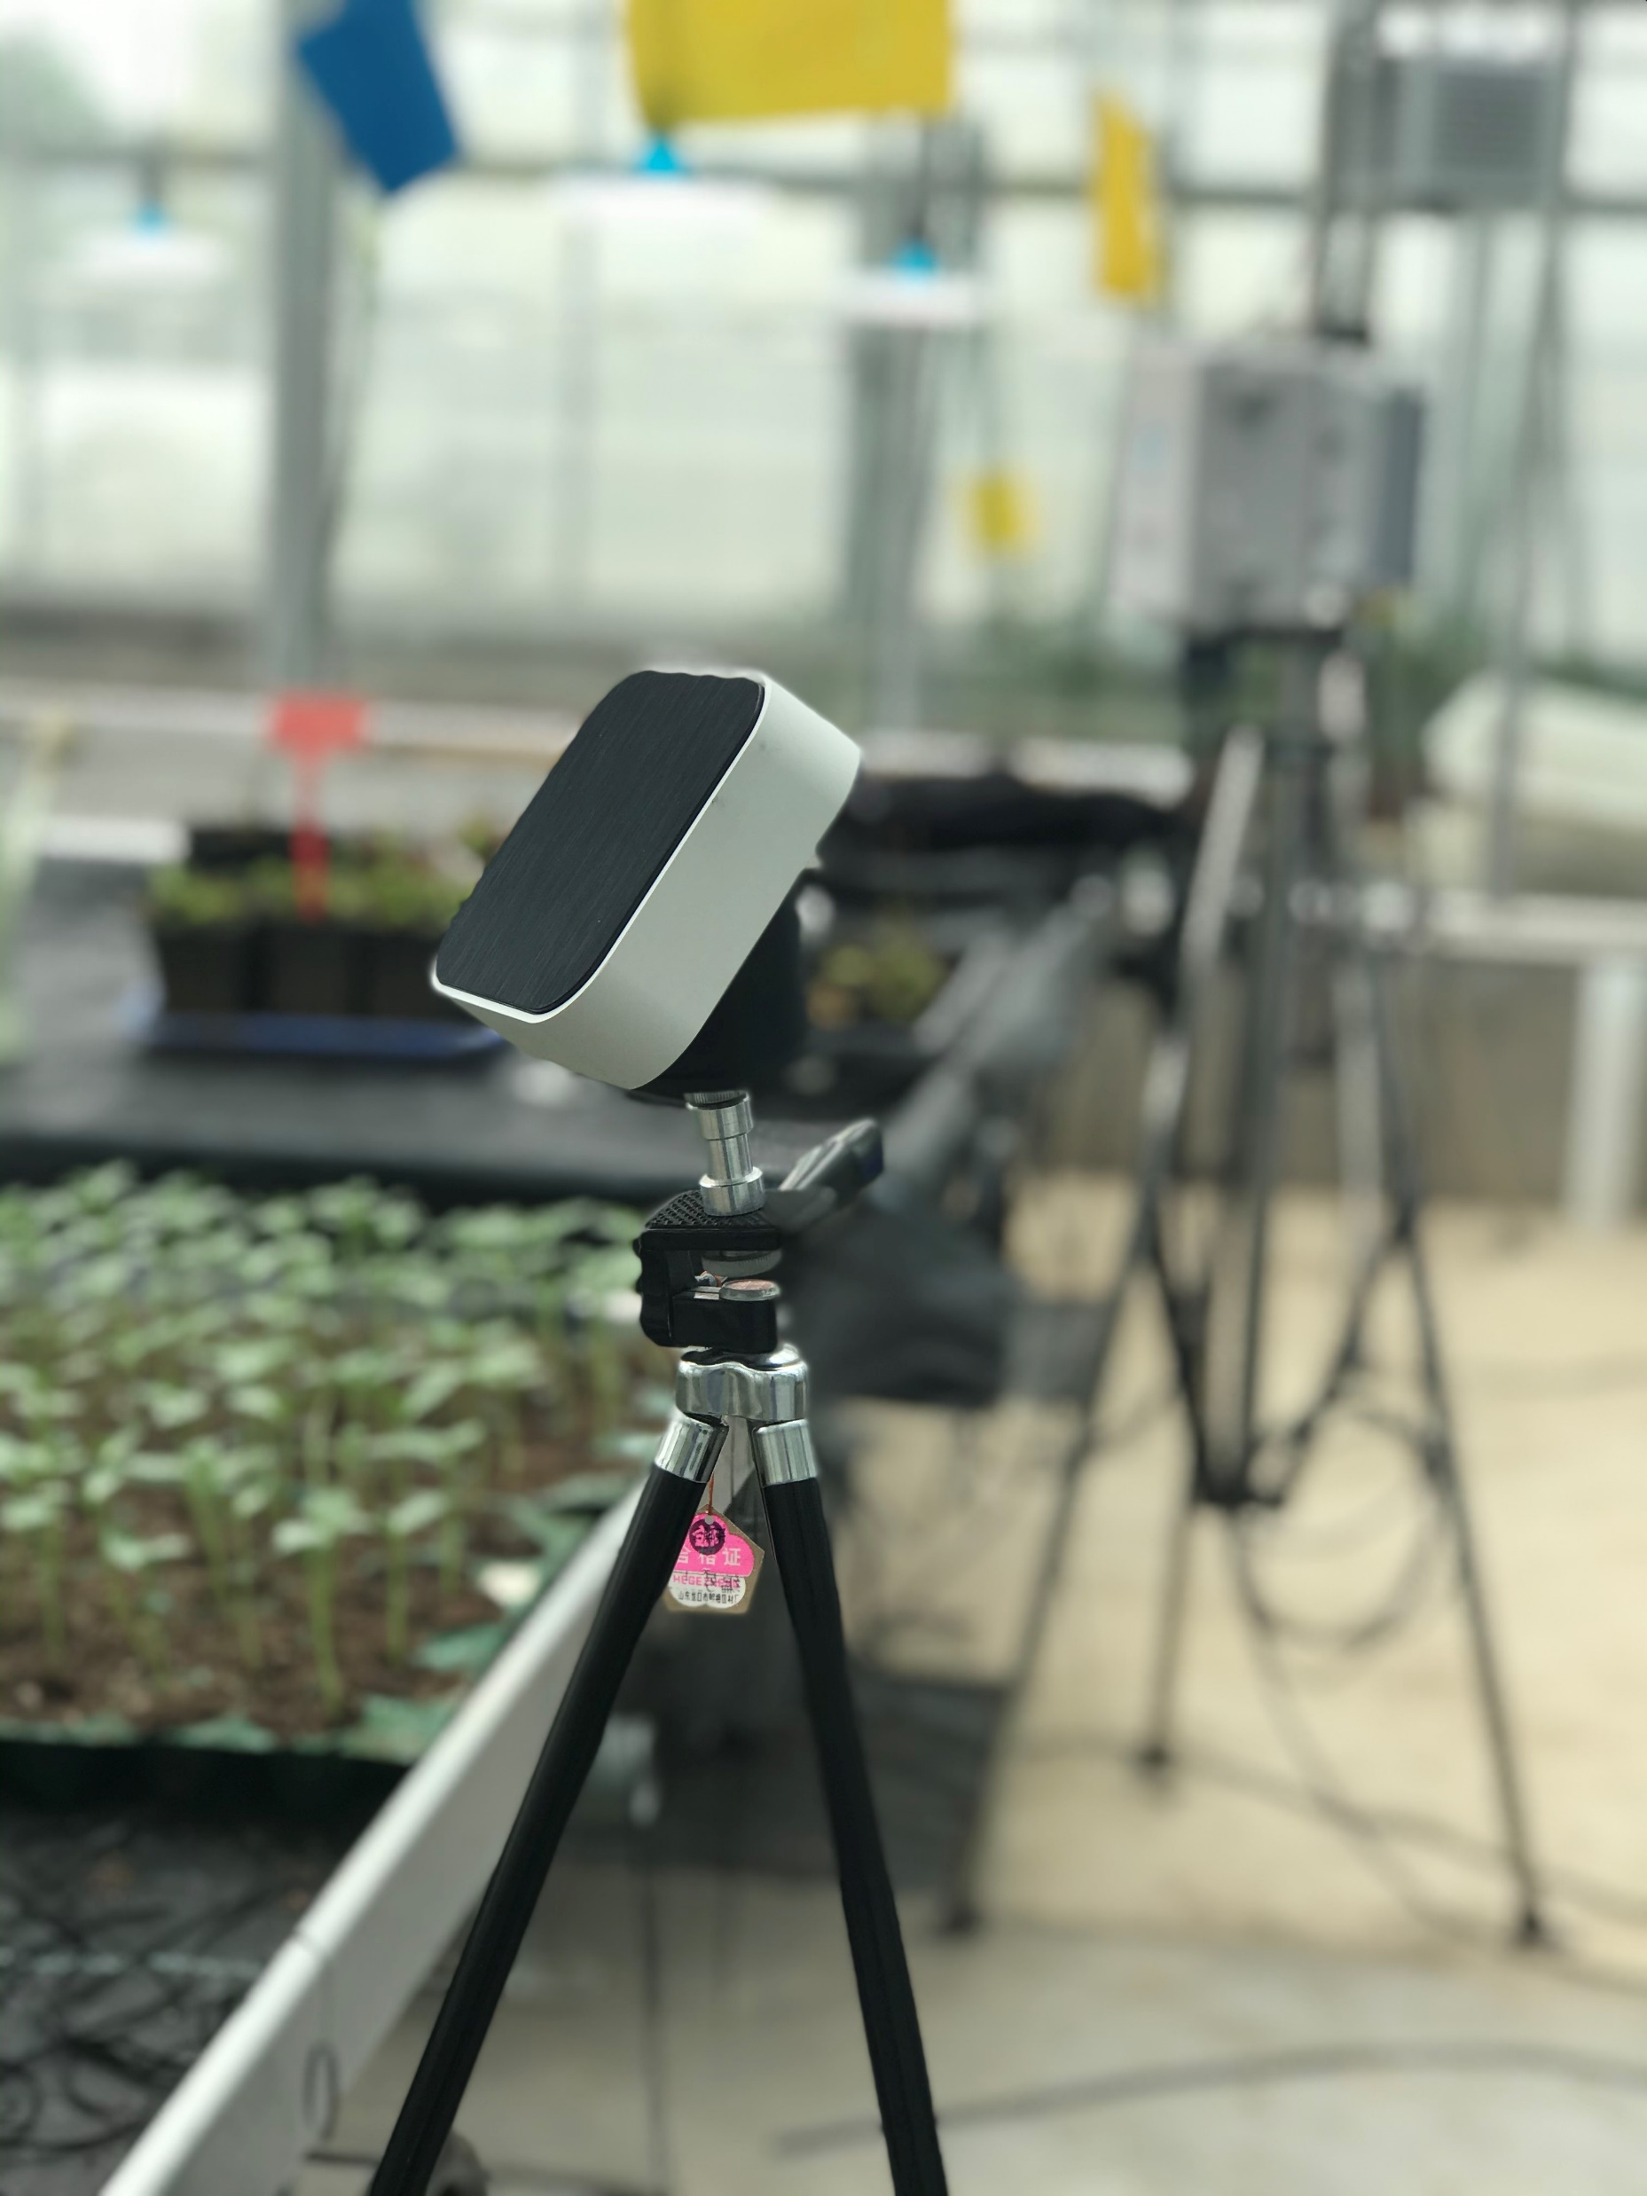
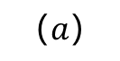
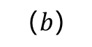
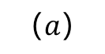
Prototype Experiments
The application of prototype system in greenhouse
$$（a）$$
$$（b）$$
$$（a）$$
The application of prototype system in greenhouse: (a) Prototype of integrated environmental factor assessment device for radiation thermal accumulation ;(b) Prototype of Edge device for crop phenotype acquisition camera;(c) smart gate way for bridge local data to CGM cloud, and fused local data of greenhouse by using propsed ECI and GCI.
Notes:
为了验证作物生长数字模型的可行性与可靠性。为此，我们以作物生长模型在线建模工具系统为案例进行研究。系统采集环境数据和蔬菜种苗生长表型数据的硬件设备原型如图所示。

Slide 17
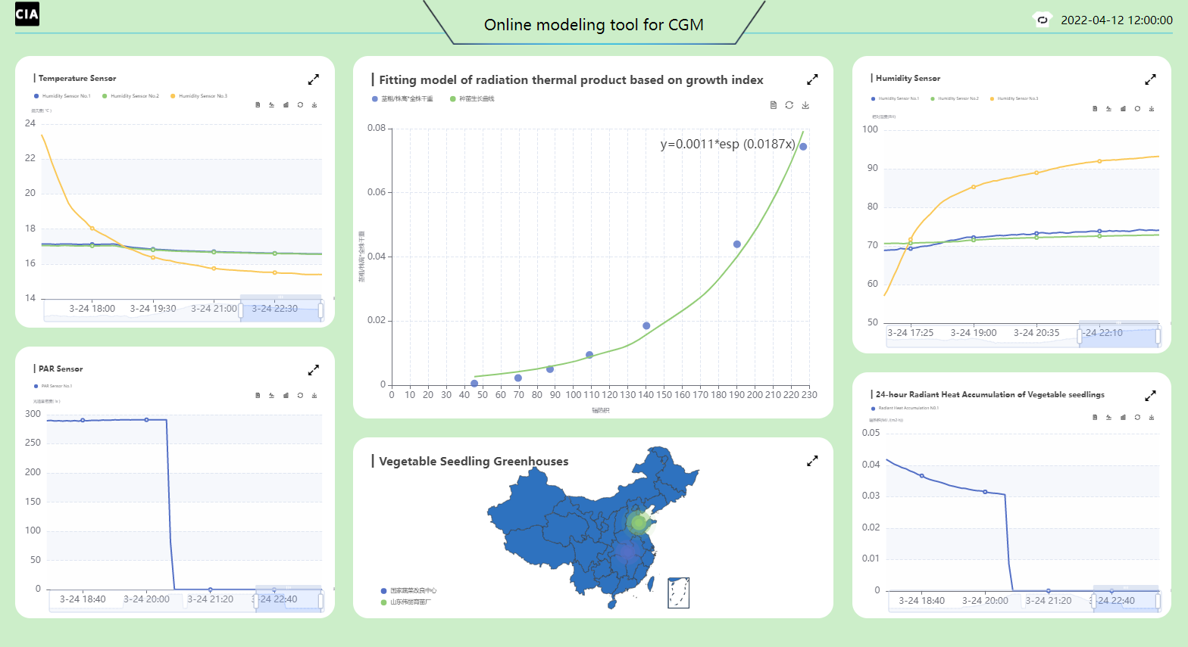
Prototype Experiments
System web application page
Notes:
作物生长模型在线建模工具系统如图所示，为用户展示了当前温室中的各种实时环境数据、辐热积和植物生长预测模型。该系统实现对蔬菜育苗生产信息的数据采集、数据处理和温室模型的选用和结果可视化。

Slide 18
04
Conclusions

Slide 19
Conclusions
A DCGM is built and a method of the coupling of multiple environmental factors is proposed.
The prototype of real-time online modeling IoT system of vegetable seedlings is designed.
The feasibility and accuracy of the growth model were verified by taking the vegetable seedling growth model as an example.

Slide 20
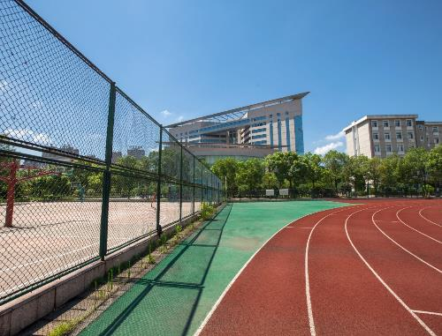
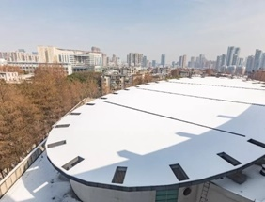
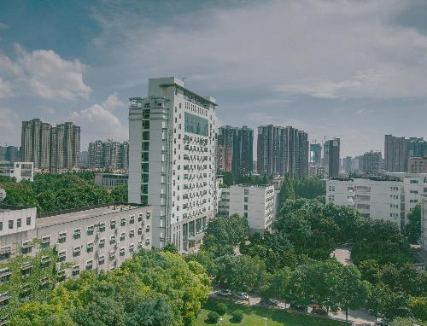

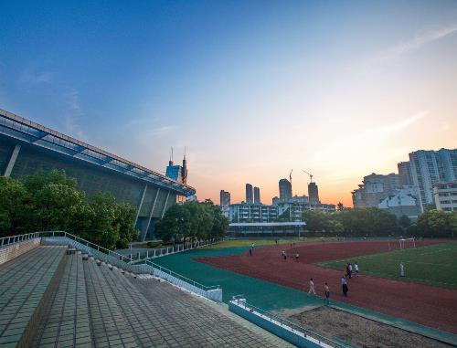

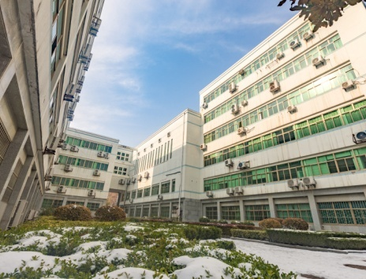
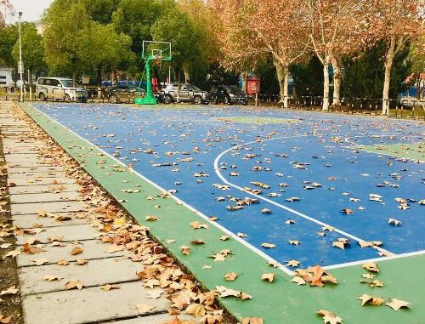

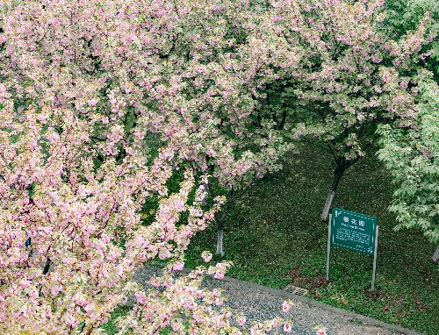
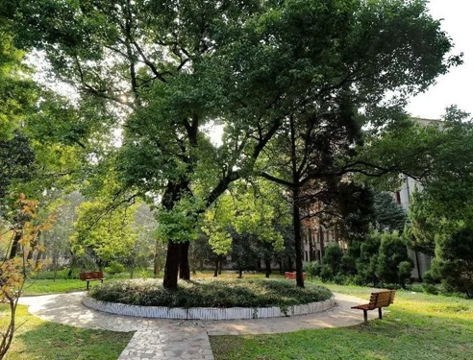
Thanks

